Slide 1
Data Mining
Fahad Maqbool
Assistant Professor
Department of Computer Science & Information Technology
University of Sargodha
fahadmaqbool@uos.edu.pk

Slide 2
Database vs. Data Mining
Query
  Well defined
  SQL
Query
  Poorly defined
  No precise query language
Output
  Subset of database
Output
  Not a subset of database
Field
  Mature
  Hard to publish a bad SIGMOD/VLDB paper
Field
  Still in infancy
  Easy to publish a bad SIGKDD paper!

Slide 3
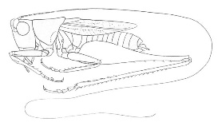
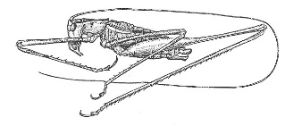
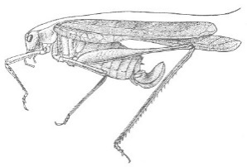
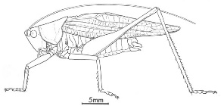
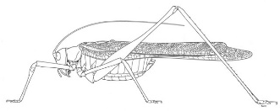
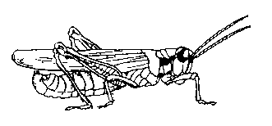
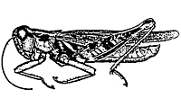
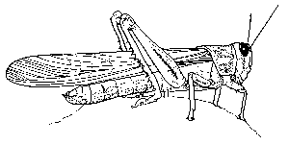
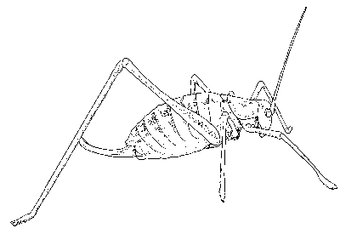
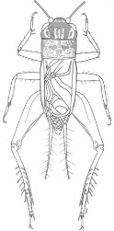
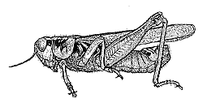
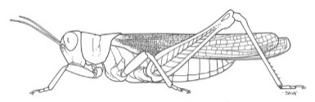
The Classification Problem
(informal definition)
Katydids
Given a collection of annotated data. In this case 5 instances Katydids of and five of Grasshoppers, decide what type of insect the unlabeled example is.
Grasshoppers
Katydid or Grasshopper?

Slide 4
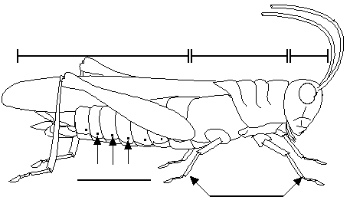
For any domain of interest, we can measure features
Color {Green, Brown, Gray, Other}
Has Wings?
Abdomen
Length
Thorax Length
Antennae
Length
Mandible
Size
Spiracle
Diameter
Leg Length

Slide 5
We can store features in a database.
My_Collection
Insect ID | Abdomen Length | Antennae Length | Insect Class
1 | 2.7 | 5.5 | Grasshopper
2 | 8.0 | 9.1 | Katydid
3 | 0.9 | 4.7 | Grasshopper
4 | 1.1 | 3.1 | Grasshopper
5 | 5.4 | 8.5 | Katydid
6 | 2.9 | 1.9 | Grasshopper
7 | 6.1 | 6.6 | Katydid
8 | 0.5 | 1.0 | Grasshopper
9 | 8.3 | 6.6 | Katydid
10 | 8.1 | 4.7 | Katydids
The classification problem can now be expressed as:
Given a training database (My_Collection), predict the class label of a previously unseen instance
previously unseen instance =
11 | 5.1 | 7.0 | ???????

Slide 6


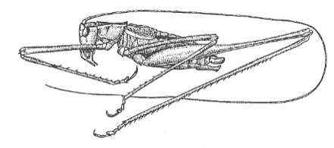
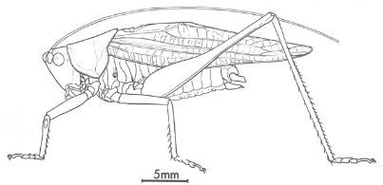
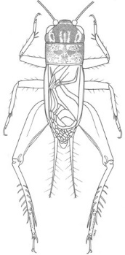



Grasshoppers
Katydids
10
9
8
7
6
Antenna Length
5
4
3
2
1
1
2
3
4
5
6
7
8
9
10
Abdomen Length

Slide 7
Grasshoppers
Katydids
We will also use this lager dataset as a motivating example…
10
9
8
7
6
Antenna Length
5
Each of these data objects are called…
exemplars
(training) examples
instances
tuples
4
3
2
1
1
2
3
4
5
6
7
8
9
10
Abdomen Length

Slide 8


We will return to the previous slide in two minutes. In the meantime, we are going to play a quick game.
I am going to show you some classification problems which were shown to pigeons!
Let us see if you are as smart as a pigeon!

Slide 9
Pigeon Problem 1
Examples of class A
Examples of class B
3 4
5 2.5
1.5 5
5 2
6 8
8 3
2.5 5
4.5 3

Slide 10


Pigeon Problem 1
What class is this object?
Examples of class A
Examples of class B
3 4
5 2.5
8 1.5
What about this one, A or B?
1.5 5
5 2
6 8
8 3
4.5 7
2.5 5
4.5 3

Slide 11

Pigeon Problem 1
This is a B!
Examples of class A
Examples of class B
3 4
5 2.5
8 1.5
1.5 5
5 2
Here is the rule.
If the left bar is smaller than the right bar, it is an A, otherwise it is a B.
6 8
8 3
2.5 5
4.5 3

Slide 12


Pigeon Problem 2
Oh! This ones hard!
Examples of class A
Examples of class B
4 4
5 2.5
8 1.5
Even I know this one
5 5
2 5
6 6
5 3
7 7
3 3
2.5 3

Slide 13

Pigeon Problem 2
Examples of class A
Examples of class B
The rule is as follows, if the two bars are equal sizes, it is an A. Otherwise it is a B.
4 4
5 2.5
5 5
2 5
So this one is an A.
6 6
5 3
7 7
3 3
2.5 3

Slide 14

Pigeon Problem 3
Examples of class A
Examples of class B
6 6
4 4
5 6
This one is really hard!
What is this, A or B?
1 5
7 5
6 3
4 8
3 7
7 7

Slide 15

Pigeon Problem 3
It is a B!
Examples of class A
Examples of class B
6 6
4 4
5 6
The rule is as follows, if the square of the sum of the two bars is less than or equal to 100, it is an A. Otherwise it is a B.
1 5
7 5
6 3
4 8
3 7
7 7

Slide 16
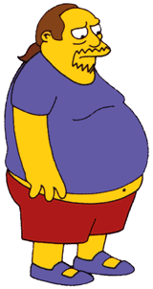

Why did we spend so much time with this game?
Because we wanted to show that almost all classification problems have a geometric interpretation, check out the next 3 slides…

Slide 17
Pigeon Problem 1
10
9
8
Examples of class A
Examples of class B
7
6
Left Bar
5
4
3
2
3 4
5 2.5
1
1
2
3
4
5
6
7
8
9
10
Right Bar
1.5 5
5 2
Here is the rule again.
If the left bar is smaller than the right bar, it is an A, otherwise it is a B.
6 8
8 3
2.5 5
4.5 3

Slide 18

Pigeon Problem 2
10
9
8
Examples of class A
Examples of class B
7
6
Left Bar
5
4
3
2
4 4
5 2.5
1
1
2
3
4
5
6
7
8
9
10
Right Bar
5 5
2 5
Let me look it up… here it is.. the rule is, if the two bars are equal sizes, it is an A. Otherwise it is a B.
6 6
5 3
3 3
2.5 3

Slide 19

Pigeon Problem 3
100
90
80
Examples of class A
Examples of class B
70
60
Left Bar
50
40
30
20
4 4
5 6
10
10
20
30
40
50
60
70
80
90
100
Right Bar
1 5
7 5
6 3
4 8
The rule again:
if the square of the sum of the two bars is less than or equal to 100, it is an A. Otherwise it is a B.
3 7
7 7

Slide 20
Grasshoppers
Katydids
10
9
8
7
6
Antenna Length
5
4
3
2
1
1
2
3
4
5
6
7
8
9
10
Abdomen Length

Slide 21
previously unseen instance =
11 | 5.1 | 7.0 | ???????
We can “project” the previously unseen instance into the same space as the database.
We have now abstracted away the details of our particular problem. It will be much easier to talk about points in space.
10
9
8
7
6
Antenna Length
5
4
3
2
1
Katydids
Grasshoppers
1
2
3
4
5
6
7
8
9
10
Abdomen Length

Slide 22
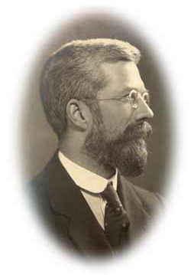
Simple Linear Classifier
10
9
8
7
R.A. Fisher
1890-1962
6
5
If previously unseen instance above the line
then
class is Katydid
else
class is Grasshopper
4
3
2
1
Katydids
Grasshoppers
1
2
3
4
5
6
7
8
9
10

Slide 23





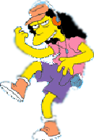



What is a natural grouping among these objects?

Slide 24

What is a natural grouping among these objects?
Clustering is subjective
Simpson's Family
School Employees
Females
Males

Slide 25
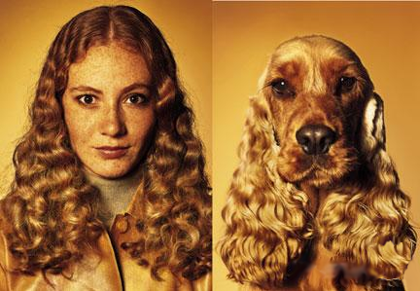
What is Similarity?
The quality or state of being similar; likeness; resemblance; as, a similarity of features.
Webster's Dictionary
Similarity is hard to define, but…
“We know it when we see it”
The real meaning of similarity is a philosophical question. We will take a more pragmatic approach.

Slide 26


Two Types of Clustering
Partitional algorithms: Construct various partitions and then evaluate them by some criterion (we will see an example called BIRCH)
Hierarchical algorithms: Create a hierarchical decomposition of the set of objects using some criterion
Hierarchical
Partitional

